Slide 1

Social Media Integration (Mobile App)
Created By:
Kumar Sundaram

Slide 2


Slide 3
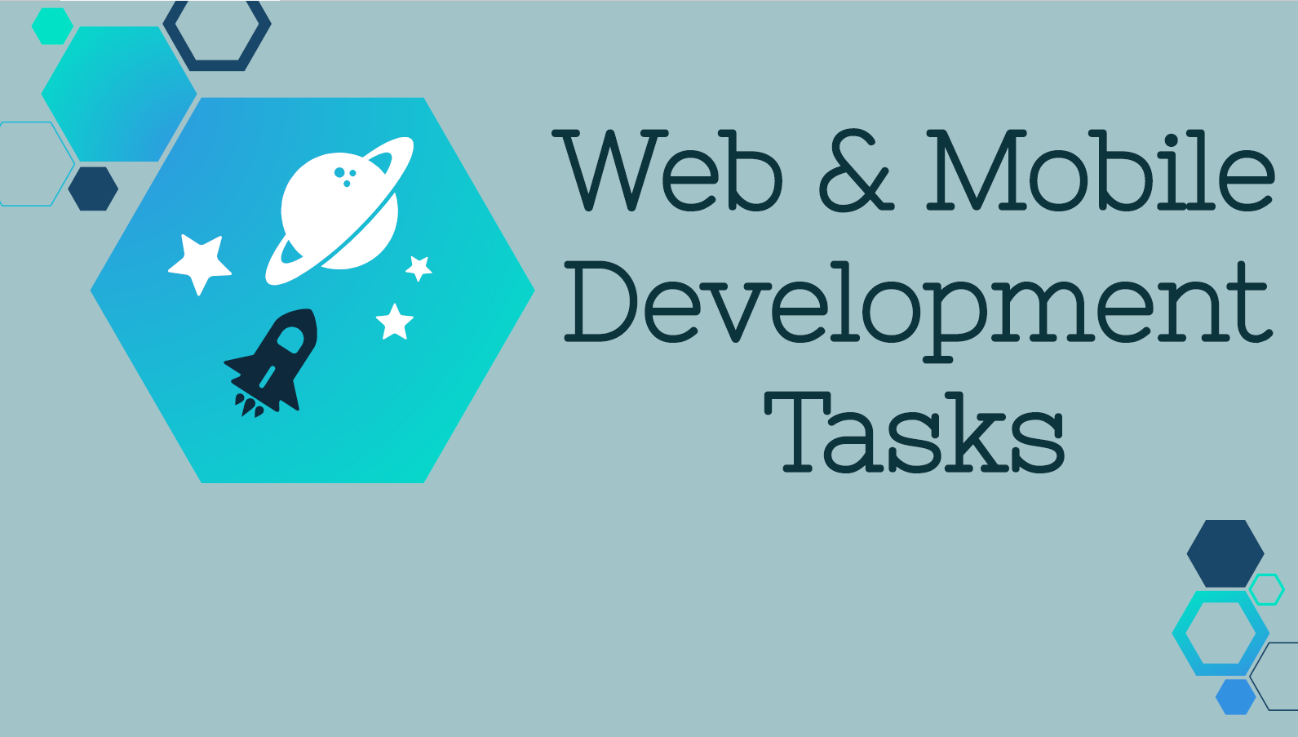

Slide 4
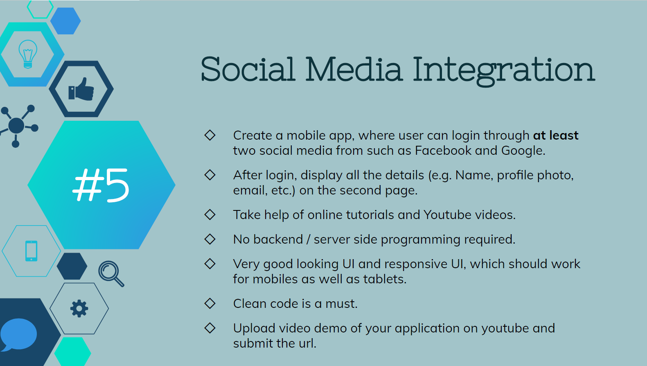

Slide 5
Thank You!

